Slide 1

Attendance Management System
Name: Aman Karn
Course:Java Programming
Department:Computer Science and Engineering
Guided By: Giridharan R Sir
Date: 1 August 2025

Slide 2
Introduction
This project is a Java-based console application that automates the process of maintaining student attendance.
It uses text files for data storage instead of a traditional database.
Designed to be simple, lightweight, and user-friendly for academic use.

Slide 3

Problem Statement
Time-consuming and prone to errors.
Difficult to maintain long-term records.
Risk of data manipulation and loss.
Lacks transparency and automation

Slide 4

Project Objectives
Automate attendance tracking using Java.
Use file handling to store and retrieve records.
Provide basic CRUD operations (Create, Read, Update, Delete).
Ensure ease of use for academic institutions.

Slide 5

Key Features
Add Student – Register new students with ID and name.
Mark Attendance – Record presence/absence by date.
View Reports – Display attendance records in readable format.
Text File Logging – All data saved in “.txt” files for persistence.

Slide 6
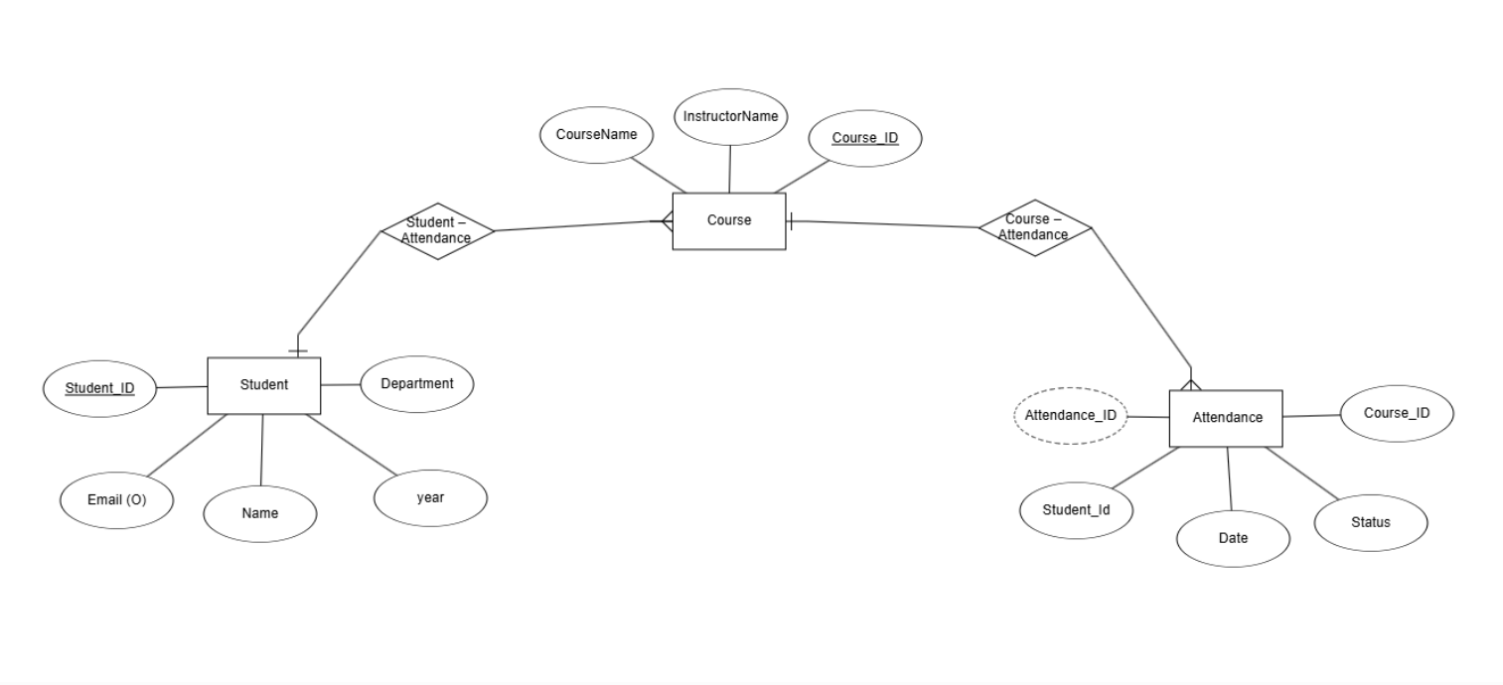
Entity-Relationship Diagram

Slide 7

Technologies & Tools Used
Java – Programming Language
File Handling – FileReader, FileWriter, BufferReader,etc
Text Files – “.txt”files for data Storage

Slide 8
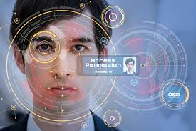
Conclusion & Future Scope
The system streamlines attendance tracking using Java and file handling.
Reduces errors, ensures better data management, and improves efficiency.
Future Enhancements:
GUI-based version using JavaFX or Swing
Integration with Excel or PDF reports
User login system
Cloud-based backup option

Slide 9

.

